Slide 1


Leads Scoring Case Study

Slide 2
Case Study Description
X Education has appointed you to help them select the most promising leads, i.e. the leads that are most likely to convert into paying customers. The company requires you to build a model wherein you need to assign a lead score to each of the leads such that the customers with a higher lead score have a higher conversion chance and the customers with a lower lead score have a lower conversion chance. The CEO, in particular, has given a ballpark of the target lead conversion rate to be around 80%
Goals:
Build a logistic regression model to assign a lead score between 0 and 100 to each of the leads which can be used by the company to target potential leads. A higher score would mean that the lead is hot, i.e. is most likely to convert whereas a lower score would mean that the lead is cold and will mostly not get converted.
There are some more problems presented by the company which your model should be able to adjust to if the company's requirement changes in the future so you will need to handle these as well. These problems are provided in a separate doc file. Please fill it based on the logistic regression model you got in the first step. Also, make sure you include this in your final PPT where you'll make recommendations.

Slide 3
Process Followed
Understanding Data | Cleaning Data | EDA | Model Preparation | Model building | Model Evaluation
Understood data set shape, column types, value range, etc. | Identified Null values and Outliers Treated them | Basic visualization Converting variables to binary Adding Dummy variables | Split data (70-30) Scaled numeric variables | Utilized logistic regression Selected features automatically using RFE Fine tuned manually using p-value and VIF | Checked accuracy, sensitivity, Specificity, ROC curve & AUC Compared results for test and train dataset

Slide 4
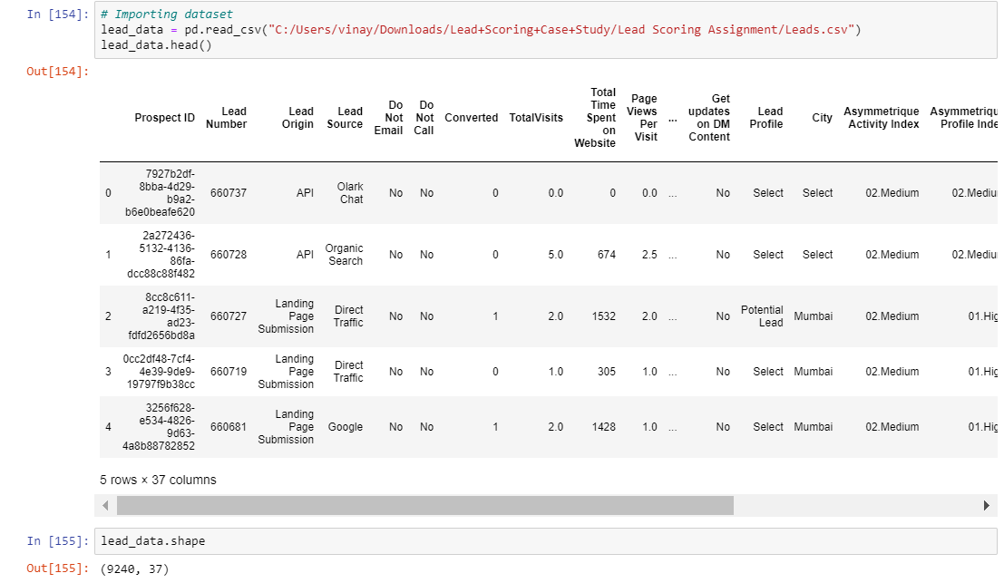
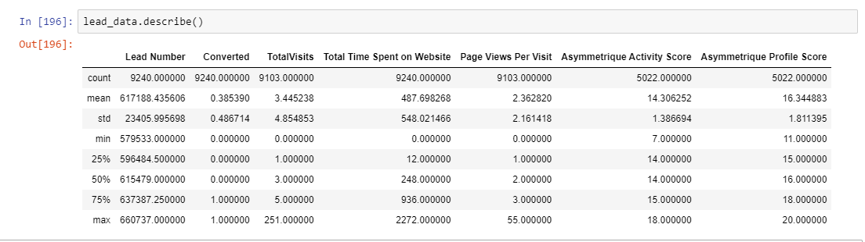
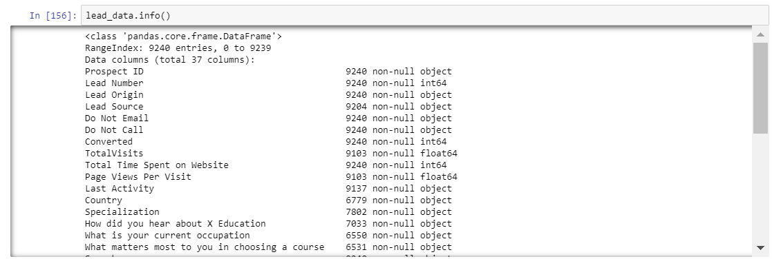
Understanding Data
We started with importing the data set and understanding it based on the type of columns, the ranges and percentiles of the numerical columns and general value breakdowns.

Slide 5
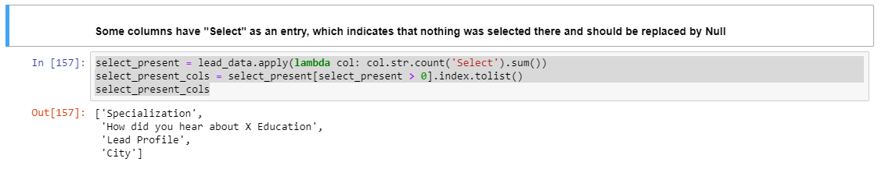
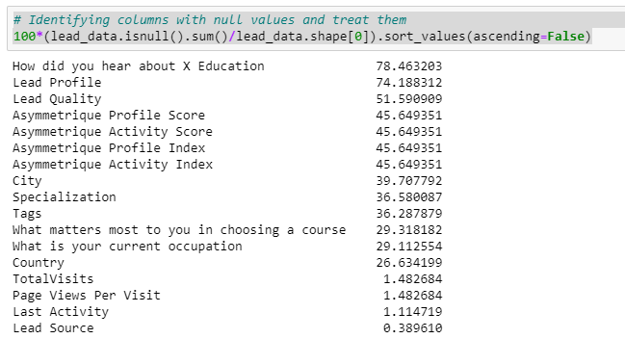
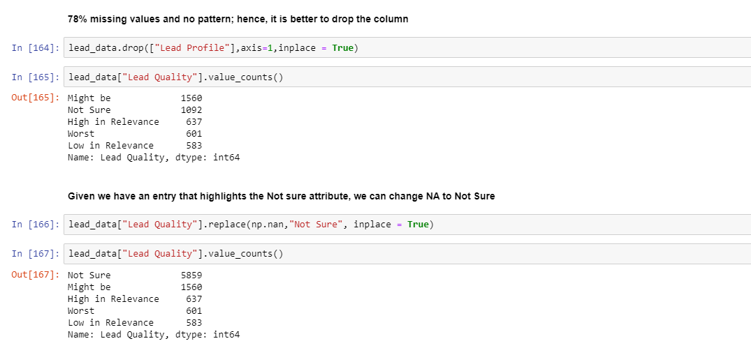
Cleaning Data
Identified columns with null values and treated them based on the data distribution. Deleted the ones that were not required and changed null to different values wherever required

Slide 6
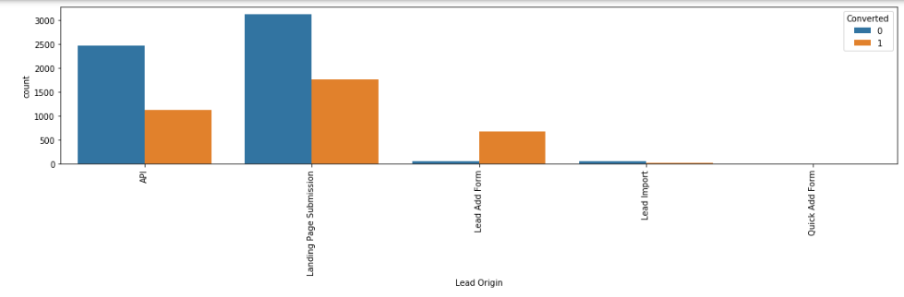
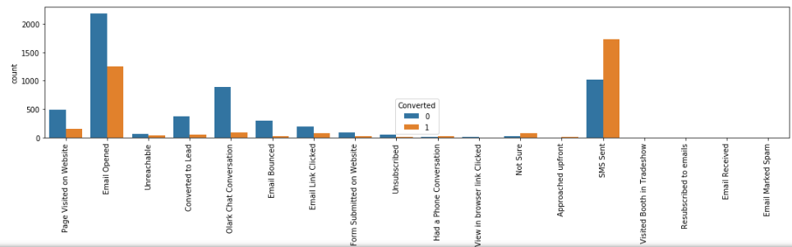
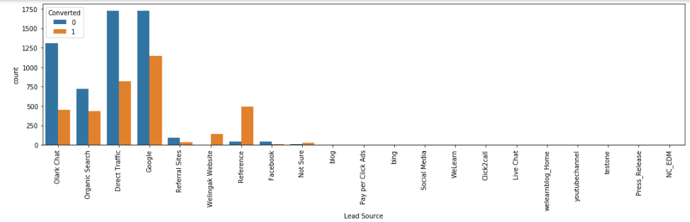
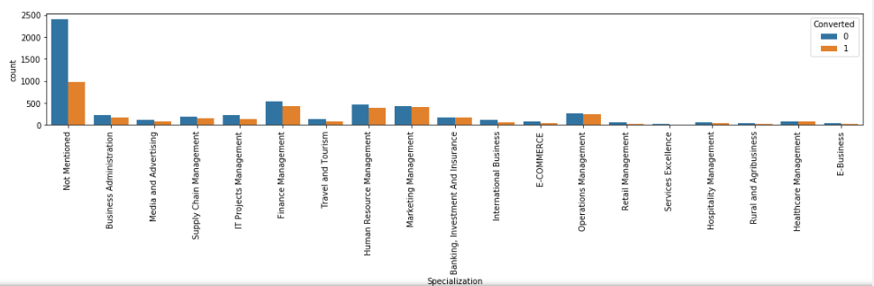
EDA
General Observations: SMS sent feature has the highest conversion, Followed by Email Opened, Modified and page visit. Lead Source feature we observe referrals ,Welinkak website have the highest conversion compared to others. Lead To Conversion Ratio for these features were noticed to be above 80% Business Swelinck & Advertising, Marketing management, Insurance & banking, OS management, health care & hospitality management

Slide 7
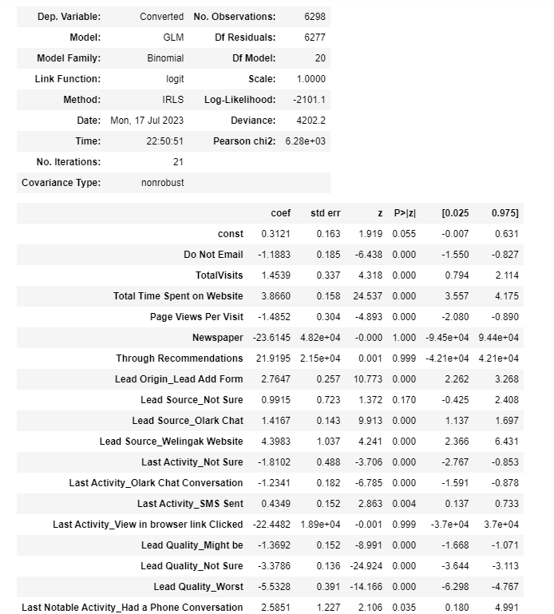
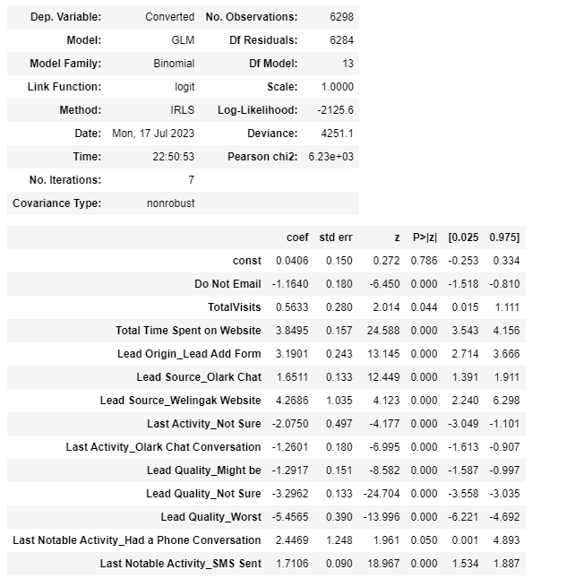
Model building
We dropped multiple variables due to their high VIF scores or their insignificant p-values. Our final model included 13 variables that were significant and provided a stable result. Organization should focus on the source from Wellingak Website and consider the time a person is spending on the website while reaching out for a sales call.
First Model
Final Model

Slide 8
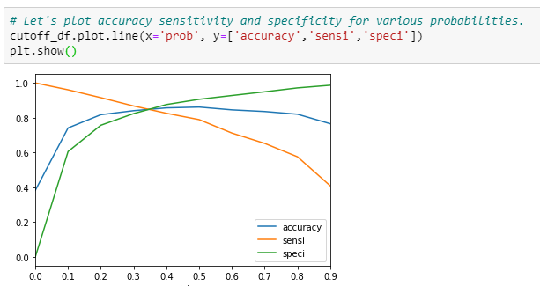
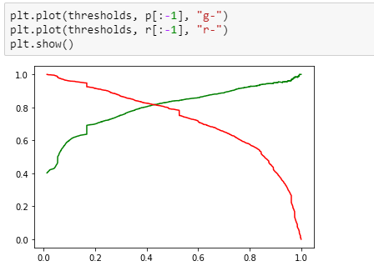
Model building
We witnessed a good increase in the number of respondents categorized as positives, which is good in our case as correct leads will result to higher revenue. A high sensitivity and specificity means that categorization is good and the organization would not waste time in reaching out to folks that might not be our customer
Train Data Prediction at cut-off 0.5
Finding Optimal Cut-off
Train Data Prediction at cut-off 0.33
Predicted/ Actual | Not Lead | Lead
Not Lead | 3524 | 366
Lead | 508 | 1900
Predicted/ Actual | Not Lead | Lead
Not Lead | 3283 | 607
Lead | 351 | 2057
Accuracy | 86%
Sensitivity | 79%
Specificity | 91%
Accuracy | 85%
Sensitivity | 85%
Specificity | 84%

Slide 9
Model Evaluation
Both the models witnessed a similar evaluation scores indicating that the model is performing well and can be considered for business purposes. A high score across evaluation metrics on test data indicates the model performs well and utilizing this by the organization would work in their favor
Final Model on Train Data
Result on Test Data
Predicted/ Actual | Not Lead | Lead
Not Lead | 3283 | 607
Lead | 351 | 2057
Predicted/ Actual | Not Lead | Lead
Not Lead | 1366 | 309
Lead | 166 | 859
Accuracy | 85%
Sensitivity | 85%
Specificity | 84%
Accuracy | 82%
Sensitivity | 84%
Specificity | 82%

Slide 10
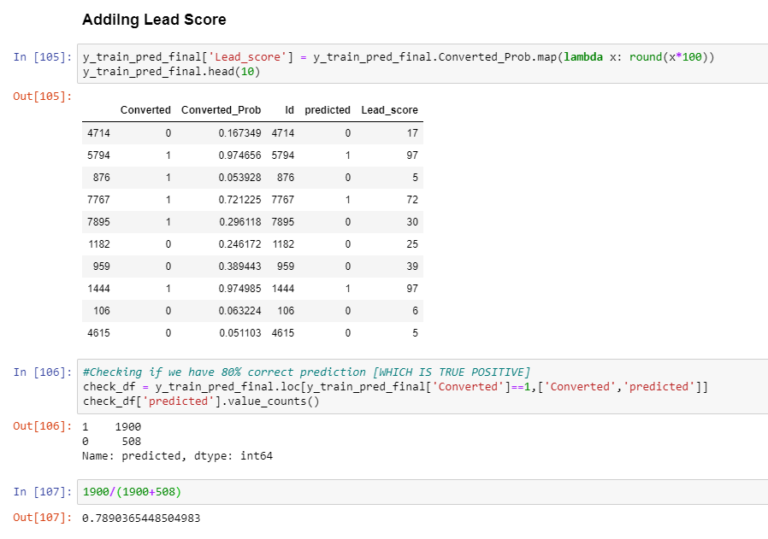
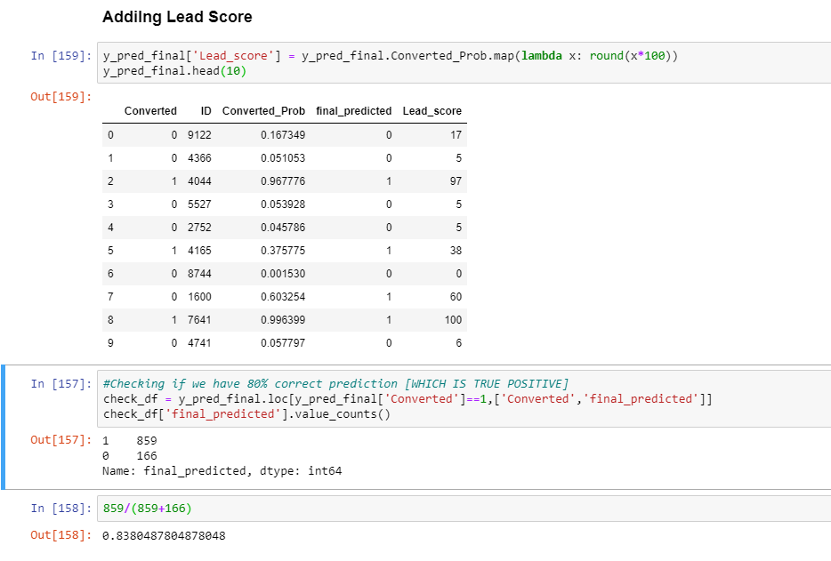
Lead Scores
Lead scores were assigned to every row to highlight if a row is a hot lead or not. While the accuracy was around 80% for the train data, it went over 80% for the test data. These lead scores can be directly utilized before a sales call and conversation should always start with the higher ones.
Lead Score on Train Data
Lead Score on Test Data

